Slide 1




Latent Profile Analysis of Cyberchondria and its Relationship with Health Information Overload and Avoidance
Haoyu Wang^{1,3}, Prof. Dr. Jingxi Chen^{2,3}*
¹ School of Journalism and Communication, Renmin University of China, Beijing, China
² College of Arts and Media, Tongji University, Shanghai, China
³ Health Communication Research Center, Tongji University, Shanghai, China

Slide 2
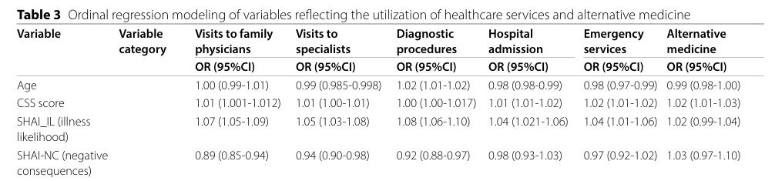
Introduction & Literature Review
Cyberchondria
Cyberchondria is a multidimensional, syndrome-like condition characterized by responses to anxiety, compulsivity, and associated negative emotional states (Starcevic et al., 2020).
A combination of behavioral patterns and concurrent emotional states (McElroy et al., 2019).
Costs
A lifetime prevalence of 5.7% for health anxiety/hypochondriasis (Hannah et al., 2023).
Cyberchondria severity was a significant predictor of the utilization (Kobryn & Duplaga, 2024).
1 / 14
Notes:
The severity of cyberchondria increases the likelihood of seeking medical consultation, hospitalization, and using emergency services by 1.01 to 1.02 times for each unit increase in severity.

Slide 3
Introduction & Literature Review
Dimensions of Cyberchondria
Cyberchondria may be better defined as a dimensional construct, on a continuum from a mild to severe behavioural and psychopathological pattern (Starcevic et al., 2020).
Four Dimensions (McElroy & Shevlin, 2014):
Compulsion: The degree to which internet searches for health information interfere with daily activities.
Distress: The tendency to experience anxiety while searching for health information online.
Excessiveness: The repetitive nature of the searches.
Reassurance: The need to seek reassurance from medical professionals or online sources.
Theories and Model
Reassurance-Seeking Model (Doherty-Torstrick et al., 2016)
Metacognition of Health Anxiety (Airoldi et al., 2022; Fergus & Spada, 2018)
2 / 14

Slide 4
Introduction & Literature Review
Variable-Centered or Person-Centered Approach ?
Variable-Centered Approach (McElroy & Shevlin, 2014; Jungmann & Witthöft, 2020)
Studying the relationships between variables across a population.
Person-Centered Approach
Instead of looking at the average effect of variables, it looks at how individuals with different profiles or patterns within the data might respond differently.
Research Question 1: What latent profiles can be identified among individuals exhibiting diverse patterns of cyberchondria?
3 / 14

Slide 5
Introduction & Literature Review
Health Information Overload, Avoidance and Cyberchondria
Health Information Overload
Excessive intake of health information becomes a burden rather than a resource (Bawden & Robinson, 2015).
Reassurance-Seeking Model: Individuals with high health anxiety engage in excessive reassurance-seeking, which fails to alleviate anxiety, perpetuating distress (Doherty-Torstrick et al., 2016).
Social Amplification of Risk Framework (SARF): Heightened exposure to health-related risks amplifies perceived risks (Li et al., 2023), contributing to health anxiety and cyberchondria.
4 / 14

Slide 6
Introduction & Literature Review
Health Information Overload, Avoidance and Cyberchondria
Health Information Avoidance
behavior intended to prevent or delay the acquisition of available but potentially unwanted information (Howell & Shepperd, 2013).
A potential strategy?
A coping mechanism to mitigate the negative effects of cyberchondria (Doherty-Torstrick et al., 2016; Laato et al., 2020).
Avoidance may help individuals with high health anxiety avoid further distress from online searches.
The complete avoidance of health information is unrealistic in an era where the Internet is a dominant source of medical knowledge (Starcevic et al., 2020).
Information avoidance can temporarily alleviate health anxiety, it is insufficient without concurrent efforts to improve health literacy and online information competency (Luo, 2019).
Research Question 2: What is the relationship between health information overload, avoidance, and the subtypes of cyberchondria?
5 / 14

Slide 7
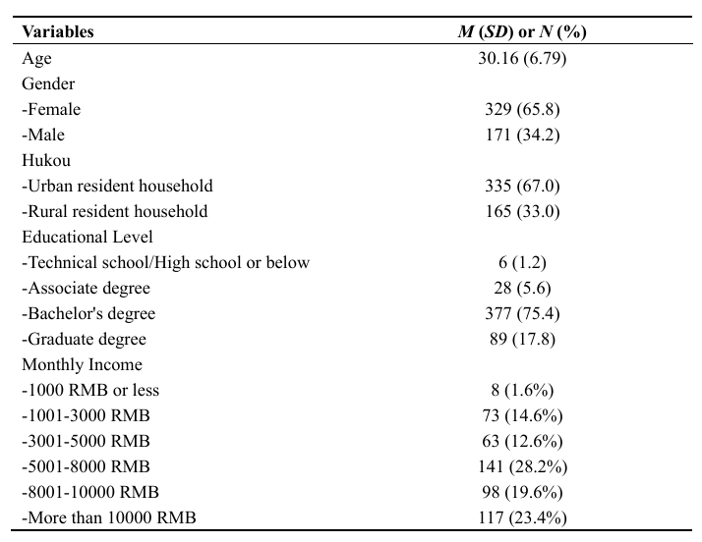
Methodology
Table 2. Demographic Variables Descriptive Statistics
Participants
Data was collected through a questionnaire, with participant recruitment facilitated by the Credamo (www.credamo.com), a member of the European Society for Opinion and Marketing Research (ESOMAR), which is recognized for adhering to international authoritative standards.
Data collection conducted from May 13th to May 17th, 2024.
500 respondents (65.8% female, N = 329; M_{age} = 30.16, SD = 6.78).
6 / 14

Slide 8
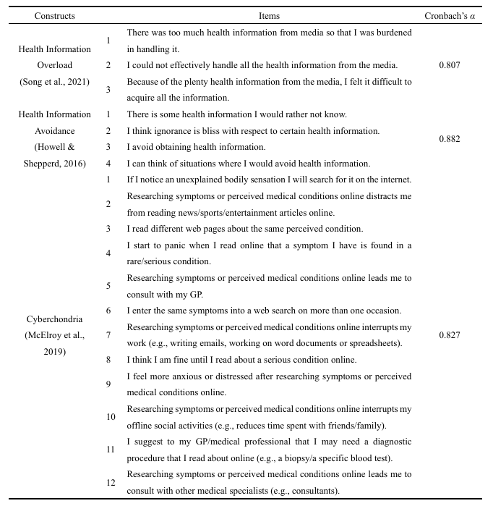
Methodology
Table 3. Constructs Measurements
Measurements
Cyberchondria
Cyberchondria Severity Scale (CSS-12; McElroy et al., 2019);
5-point Likert scale (M ± SD = 3.63 ± 0.63, Cronbach’s α = 0.827)
Health Information Overload and Avoidance
Health information overload was measured using three items adapted from Song et al. (2021); Health information avoidance was assessed with four items from Howell & Shepperd’s (2016) research.
5-point Likert scale (M_{overload} ± SD_{overload} = 2.87 ± 1.17, Cronbach’s α_{overload} = 0.807; M_{avoidance}± SD_{avoidance} = 2.36 ± 0.90, Cronbach’s α_{avoidance} = 0.882).
7 / 14

Slide 9
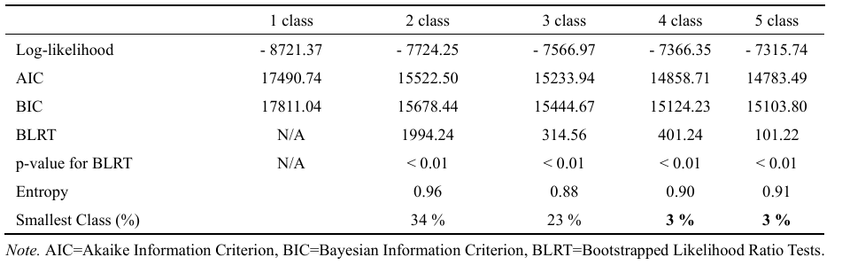











Data Analysis & Results
Latent Profile Analysis of Cyberchondria
R version 4.3.1, tidyLPA package
Akaike Information Criterion (AIC): Lower values indicate a better model fit.
Bayesian Information Criterion (BIC): Lower values indicate a better model fit.
Log-Likelihood (LL): Lower values indicate a better model fit.
Bootstrap Likelihood Ratio Test (BLRT): A p-value < 0.05 suggests that the k-class model provides a statistically superior fit compared to the k-1 class model.
Entropy: Values ≥ 0.8 indicate over 90% classification accuracy.
Table 4. Results of model fitting for potential latent analysis of cyberchondria
8 / 14

Slide 10
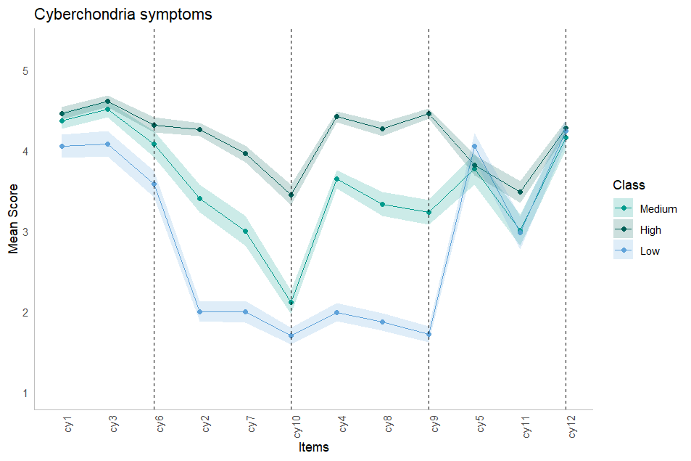
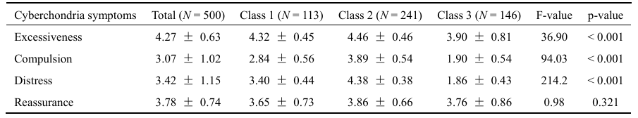







Data Analysis & Results
Latent Profile Analysis of Cyberchondria
Research Question: What latent profiles can be identified among individuals exhibiting diverse patterns of cyberchondria?
Medium Compulsion and Distress Group
22.6% of the sample (N = 113)
Scores around the mean on compulsion and distress dimensions
High Compulsion and Distress Group
48.2% of the sample (N = 241)
Higher-than-average scores on both compulsion and distress
Low Compulsion and Distress Group
29.2% of the sample (N = 146)
lower scores on excessiveness, compulsion, and distress dimensions
Table 5. Descriptive statistics and test of difference for each latent category of cyberchondria on different dimensions
9 / 14

Slide 11
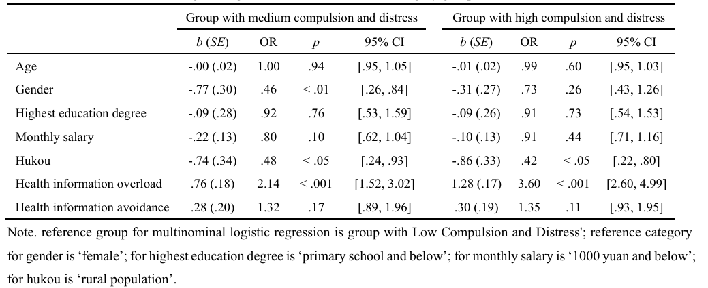
Data Analysis & Results
The relationship between health information overload, avoidance and subtypes of cyberchondria
Logistic Regression, R version 4.3.1, nnet package
Gender Differences:
Females are more likely than males to belong to the medium compulsion and distress group (OR = 0.46, p < 0.01).
Hukou Status:
Urban residents are less likely than rural residents to belong to the medium (OR = 0.48, p < 0.05) or high compulsion and distress group (OR = 0.42, p < 0.05).
Health Information Overload:
Participants with higher levels of information overload are significantly more likely to be in the medium (OR = 2.14, p < 0.001) or high compulsion and distress group (OR = 3.60, p < 0.001).
Health Information Avoidance:
Avoidance behaviors do not significantly impact classification into the medium (OR = 1.32, p > 0.05) or high compulsion and distress group (OR = 1.35, p > 0.05).
Table 6. Results of multinomial logistic regressions on the three latent category groups
10 / 14

Slide 12
Conclusion & Discussion
Heterogeneity within cyberchondria
Different combinations of psychological dimensions.
Personized Interventions
Key Intervention Targets
Compulsion
Reduce excessive health-related search behaviors.
Provide health information management skills and guide users toward balanced information-seeking behaviors.
Distress
Alleviate psychological stress.
Implement emotional management and psychological support interventions, such as Cognitive Behavioral Therapy (CBT) and relaxation training.
11 / 14

Slide 13
Conclusion & Discussion
Population Differences in Intervention Design
Gender Differences
Women are more likely to belong to the medium Compulsion and Distress group.
Associated with higher health-related anxiety and more frequent health information-seeking behavior (Lagoe & Atkin, 2015; WHO, n.d.).
Hukou Status Differences
Rural residents are more likely to belong to the medium or high Compulsion and Distress groups.
Lower health literacy and socioeconomic factors contribute to higher health anxiety (Li et al., 2021).
Another Dimension of Digital and Health Inequality
Access to the internet, but problematic usage.
The digital divide is not fully bridged.
12 / 14

Slide 14
Conclusion & Discussion
Role of Information Behavior
Health Information Overload
A significant predictor for the medium and high Compulsion and Distress groups.
Based on the Social Amplification of Risk Framework (SARF)
High exposure to risk-related information intensifies health anxiety and compulsive behaviors (Zheng et al., 2023; Li et al., 2023).
Health Information Avoidance
Not a significant predictor of cyberchondria subtypes.
While avoidance may temporarily reduce anxiety, it is insufficient for preventing cyberchondria (Starcevic et al., 2020; Roth & Cohen, 1986).
13 / 14

Slide 15
References
Hannah, K., Marie, K., Olaf, H., Stephan, B., Andreas, D., Wilson Michael, L., ... & Peter, D. (2023). The global economic burden of health anxiety/hypochondriasis-a systematic review. BMC Public Health, 23(1), 2237.
Kobryn, M., & Duplaga, M. (2024). Cyberchondria severity and utilization of health services in Polish society: a cross-sectional study. BMC Public Health, 24(1), 902.
McElroy, E., & Shevlin, M. (2014). The development and initial validation of the cyberchondria severity scale (CSS). Journal of anxiety disorders, 28(2), 259-265.
Starcevic, V., Berle, D., & Arnáez, S. (2020). Recent insights into cyberchondria. Current Psychiatry Reports.
McElroy, E., & Shevlin, M. (2014). The development and initial validation of the cyberchondria severity scale (CSS). Journal of Anxiety Disorders, 28(2), 259-265.
Doherty-Torstrick, E. R., Walton, K. E., & Fallon, B. A. (2016). Cyberchondria: Parsing health anxiety from online behaviour. Psychosomatics, 57(4), 390-400.
Li, J., Li, L., Liu, T., Ming, W. K., & Meng, S. (2023). Social media amplification of risk perceptions of and attitudes toward COVID-19 vaccination among older Chinese adults. Chinese Journal of Communication, 16(2), 115-131.
Howell, J. L., & Shepperd, J. A. (2013). Reducing health-information avoidance through contemplation. Psychological Science, 24(9), 1696-1705.
Laato, S., Islam, A. N., Islam, M. N., & Whelan, E. (2020). What drives unverified information sharing and cyberchondria during the COVID-19 pandemic? European Journal of Information Systems, 29(3), 288-305.
Bawden, D., & Robinson, L. (2015). Introduction to information science. Facet Publishing.
Lagoe, C., & Atkin, D. (2015). Health literacy and online health information: a new research agenda. ITALICS.
World Health Organization. (n.d.). Anxiety disorders. World Health Organization. Retrieved October 31, 2024, from https://www.who.int/news-room/fact-sheets/detail/anxiety-disorders#:~:text=Symptoms%20often%20begin%20during%20childhood%20or%20adolescence%20and,experience%20an%20anxiety%20disorder%20than%20boys%20and%20men.
Roth, S., & Cohen, L. J. (1986). Approach, avoidance, and coping with stress. American Psychologist, 41(7), 813-819.
Zheng, H., Chen, X., Jiang, S., & Sun, L. (2023). How does health information seeking from different online sources trigger cyberchondria? The roles of online information overload and information trust. Information Processing & Management, 60(4), 103364.
14 / 14

Slide 16
Thank you
Haoyu Wang
E-mail: wanghaoyu@ruc.edu.cn
School of Journalism and Communication, Renmin University of China
Health Communication Research Center, Tongji University

